Slide 1


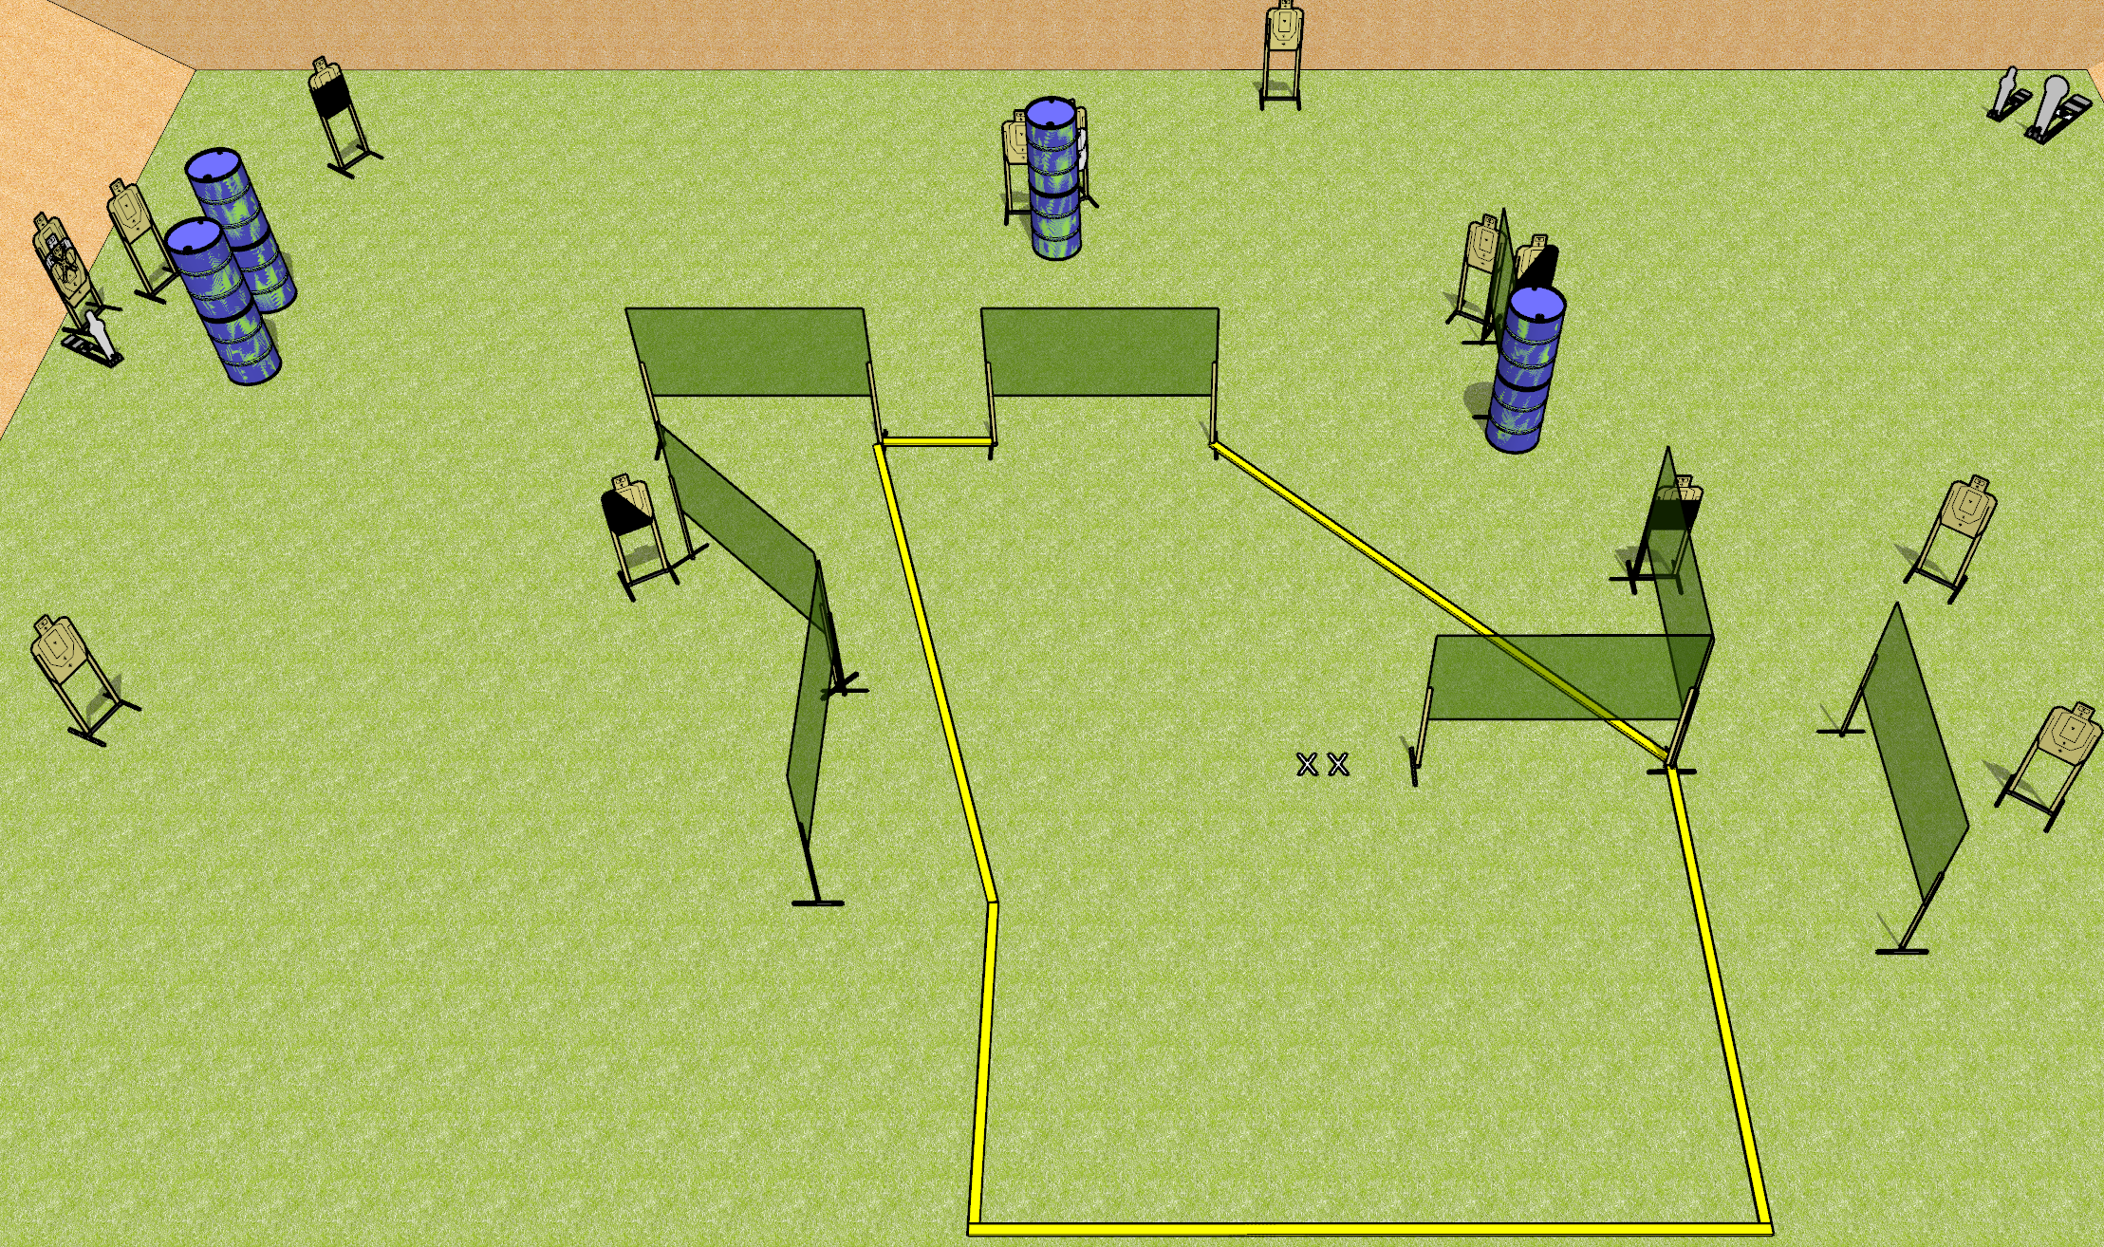
 | Dothan Gun Club – USPSA Match Big Chicken Course Designer : Drew Coleman
31 rounds 14 USPSA 1 colt popper, 2 mini poppers
Equipment List 15 wall feet 1 left and 1 right diagonal HC, 2 50%

Slide 2
Big Chicken
Written Stage Briefing
Big Chicken is a 31 round, 155 point, Comstock field course. There are 14 USPSA targets, 1 colt popper, and 2 USPSA mini poppers. The best 2 hits on paper will score, and steel must fall to score. The start signal is audible.
Handgun start position is both feet on X’s, wrists below belt. Handgun is loaded and holstered.
PCC start position is both feet on X’s. Loaded carbine is held with both hands, stock on belt, safety on.
On start signal engage targets as they become available from within the shooting area.

